Slide 1
Introduction to Immersive Technologies
JPP SIG CP2

Slide 2
VR, AR and MR
JPP SIG CP2

Slide 3
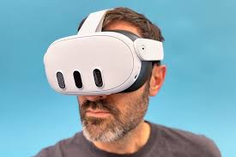
Virtual Reality - VR
VR immerses users in a fully digital environment, completely separate from the real world.
Users wear a VR headset that blocks out the physical surroundings and replaces them with a simulated environment, often 3D and interactive.
Example: Oculus Rift or HTC Vive games, where users can explore and interact with a virtual world, such as walking through a digital forest or playing a game in a completely fictional environment.

Slide 4
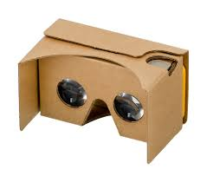
Google Cardboard Demo
https://www.instructables.com/How-to-make-Google-Cardboard/

Slide 5
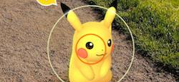
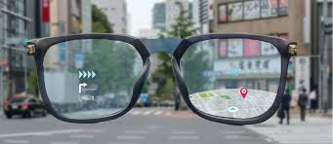
Augmented Reality - AR
AR overlays digital content onto the real world.
It enhances the physical environment by adding computer-generated elements, such as images, videos, or sounds, which users can see and interact with through devices like smartphones, tablets, or AR glasses.
Example: Pokémon GO, where players see Pokémon in the real world through their phone screens.

Slide 6
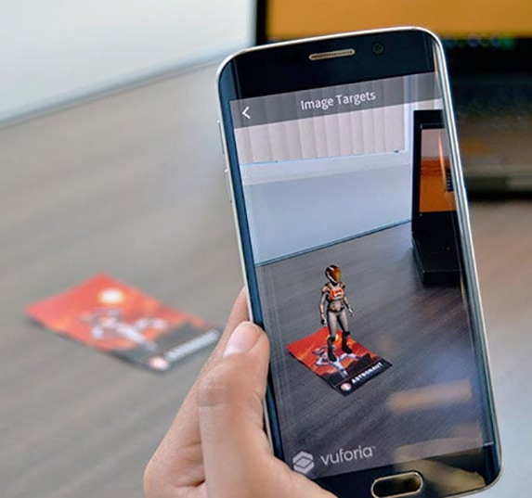
Vuforia viewer demo
https://play.google.com/store/apps/details?id=com.ptc.vuforiaview&hl=en_IN

Slide 7

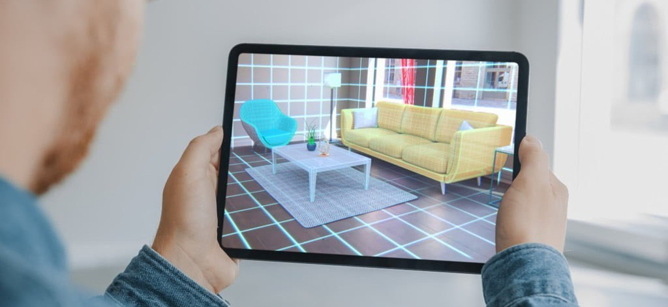
Applications / Use cases
Shopping
Jewelry / Fashion accessories
Furniture

Slide 8
Mixed Reality - MR
MR combines elements of both AR and VR, blending the physical and digital worlds in such a way that they can interact with each other in real-time.
Unlike AR, where digital content only overlays the real world, MR allows for more complex interactions, where virtual objects can interact with the physical environment.
Example: Microsoft HoloLens, where digital objects, like a 3D model, can be placed in a real room, and users can interact with them as if they were physical objects.

Slide 9
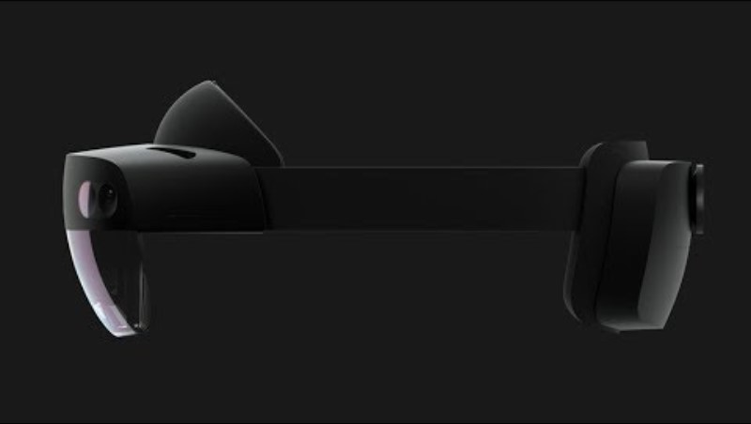
Video demo

Slide 10
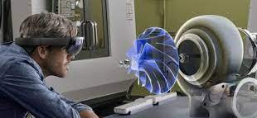
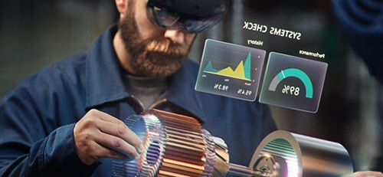
MR Applications
Industrial applications
Complex machinery repairs / maintenance / installation / training

Slide 11
Summary
AR enhances the real world with digital overlays.
VR creates a completely digital world, blocking out the real one.
MR blends the real and digital worlds, allowing for interaction between them.

Slide 12
Thanks

